Slide 1
CBRN-Analysis NG Demonstration
Continuous Improvement Working Group (CIWG) 5th / 6th November 2025
Keith McGonigle
Training and SME

Slide 2
CBRN-Analysis NG
Overview
CBRN-Analysis NG
Scenario
CBRN-Analysis NG
Message Databases and Templates
How to integrate external tools
CBRN-Analysis NG
Unit Database
CBRN-Analysis NG
Unit at Risk

Slide 3
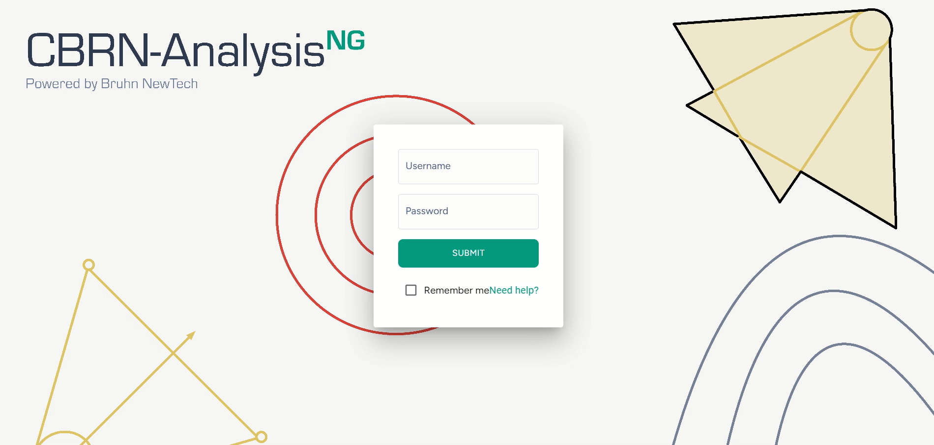
CBRN-Analysis NG Demonstration
CIWG 2025

Slide 4
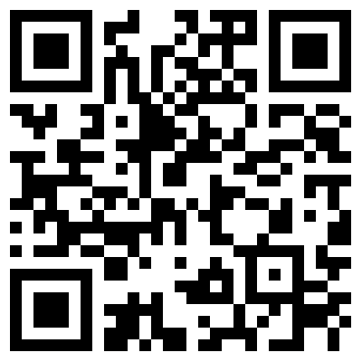

Slide 5
COMPANY PROTECT – NOT FOR GENERAL RELEASE – BRUHN NEWTECH COPYRIGHT©2025

